Slide 1
Making Changes in Webpages Discoverable: A Change-Text Search Interface for Web Archives
Lesley Frew, Michael L. Nelson, Michele C. Weigle
Web Science and Digital Libraries (WS-DL) Group
Department of Computer Science
Old Dominion University
Norfolk, VA, USA
@WebSciDL @lesley_elis ACM/IEEE JCDL 2023 June 27, 2023
Notes:
Introduce yourself
WS-DL
I’ll be presenting
This work was completed with

Slide 2
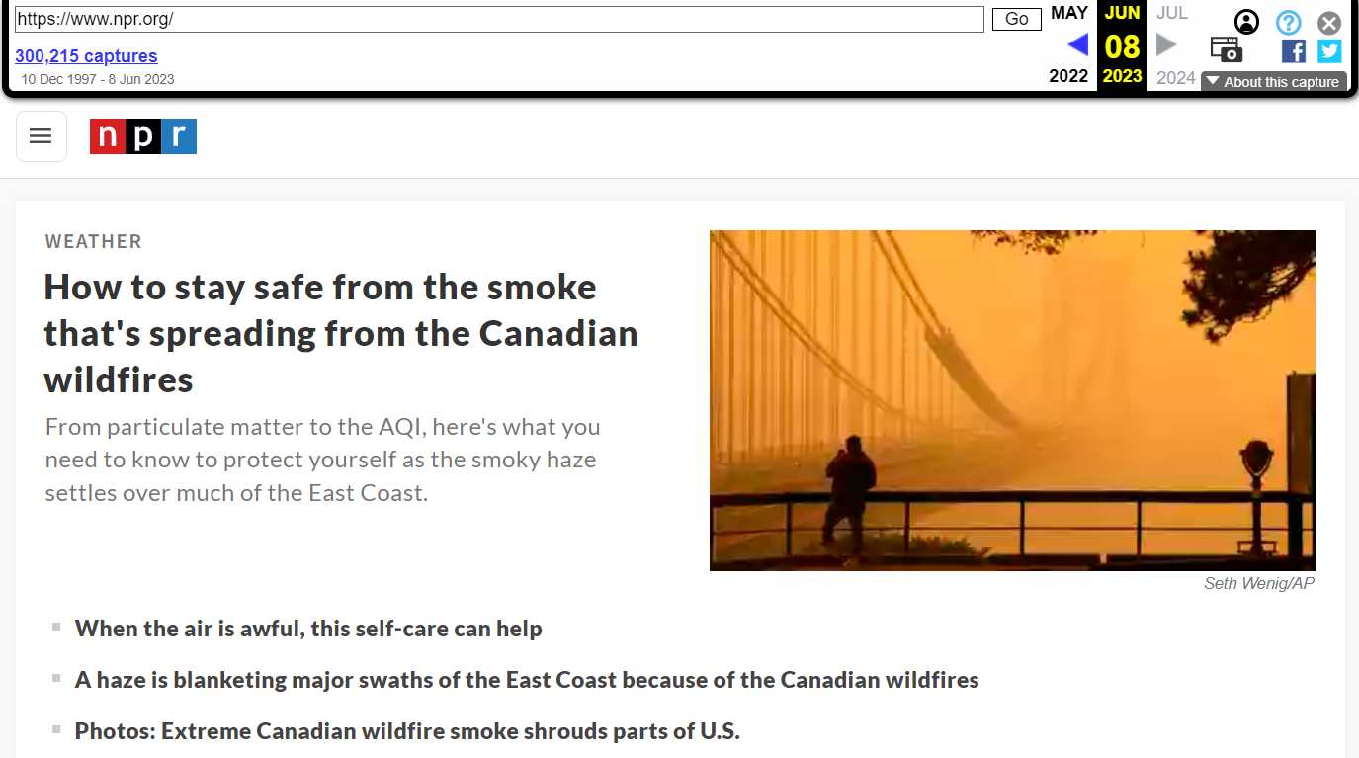
Web archives preserve historical versions of webpages
http://web.archive.org/web/20230608123313/https://www.npr.org/
@WebSciDL @lesley_elis ACM/IEEE JCDL 2023
Notes:
When we view a webpage, we expect to see the most current version.
Webpages change, or get deleted.
What if we want to view one of these previous versions?
Thanks to web archives, we are able to view some of these past versions of web pages.

Slide 3
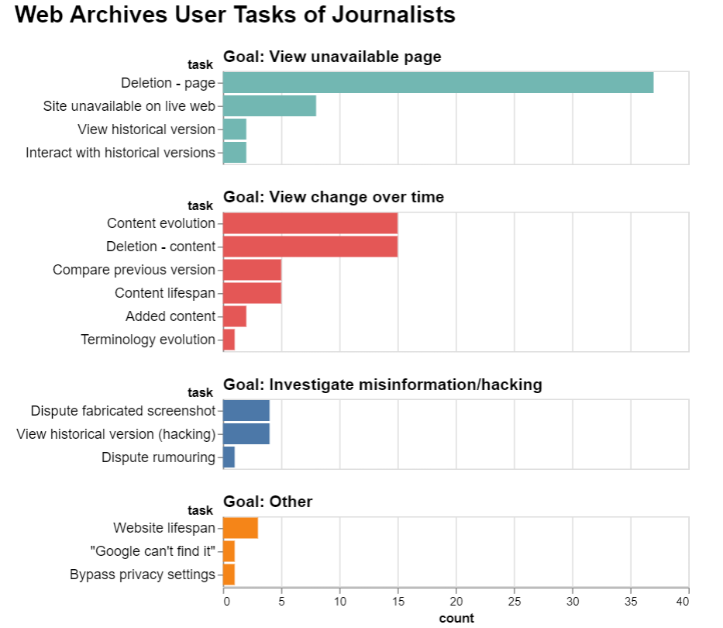
Journalists use web archives to view change over time
Figure 5
Lesley Frew, 2022-08-04: Web Archiving in Popular Media II: User Tasks of Journalists, https://ws-dl.blogspot.com/2022/08/2022-08-04-web-archiving-in-popular.html
@WebSciDL @lesley_elis ACM/IEEE JCDL 2023
Notes:
Journalists use web archives as evidence in their articles.
Many times, web page deleted.
Other times, the webpage has changed: content has been added or removed.
Journalists use web archives to view and compare different versions of web pages over time.

Slide 4
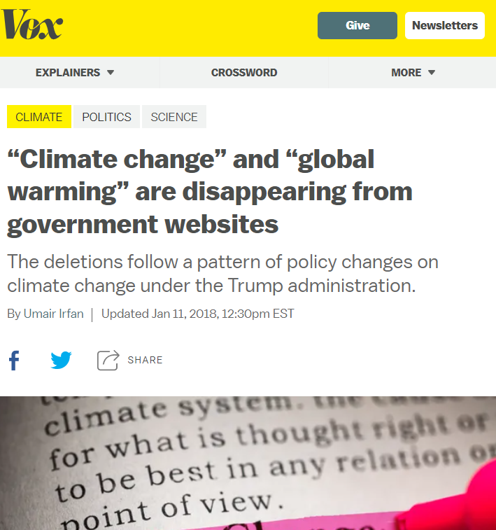
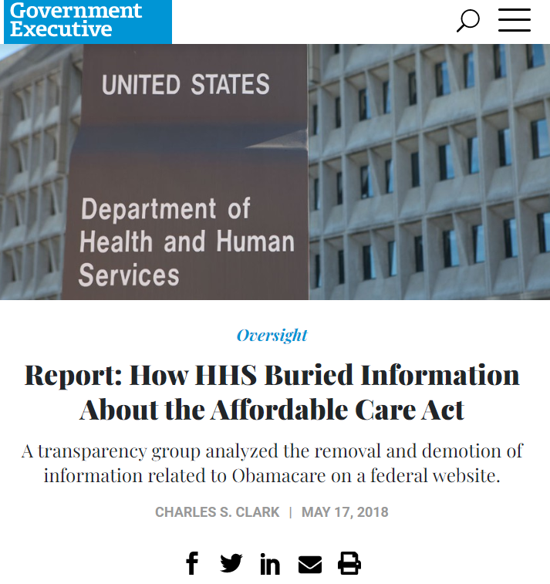
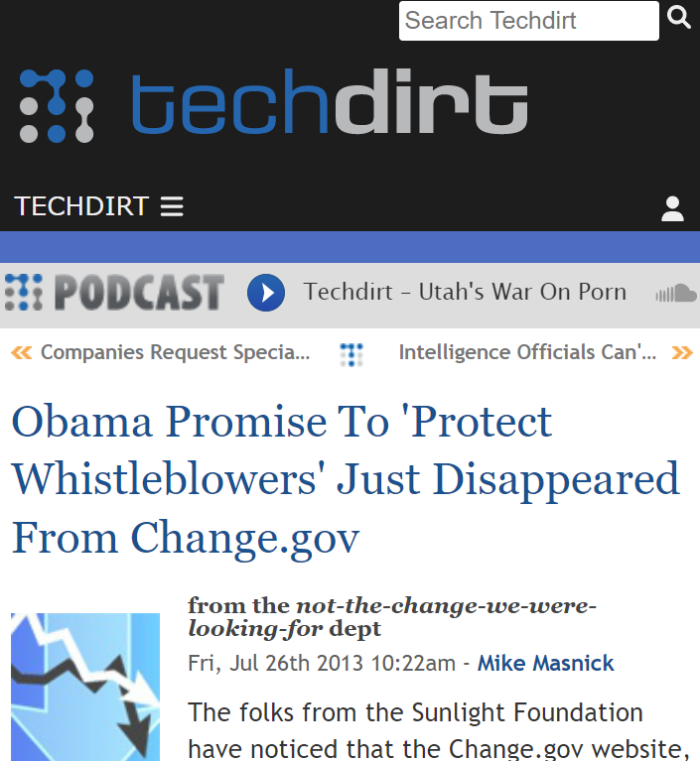
Researchers and the public are both interested in how government websites change between administrations
Vox.com GovExec.com TechDirt.com
@WebSciDL @lesley_elis ACM/IEEE JCDL 2023
Notes:
Not just journalists
The end of term archive, Environmental data and governance initiative
Volunteer organization, find changes, create reports and visualizations, bring awareness
Hold government accountable – no US law
examples US websites 2016-2020 in this presentation

Slide 5
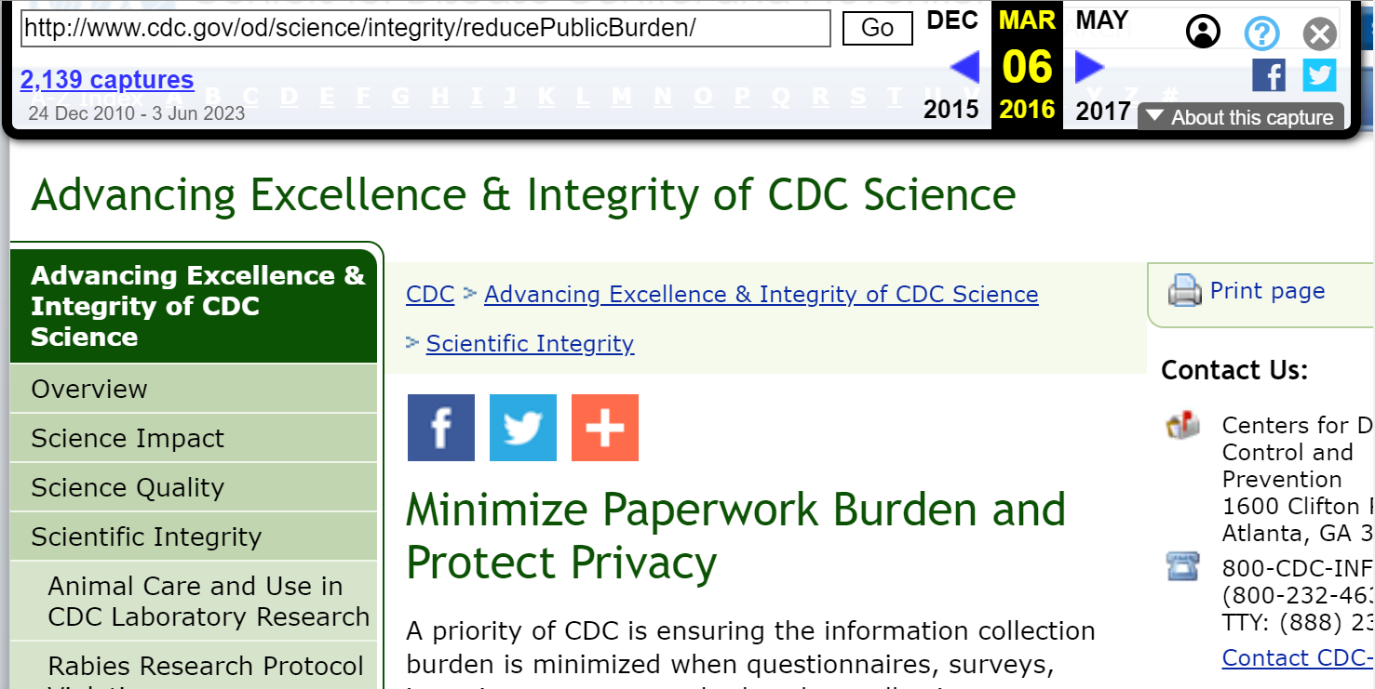
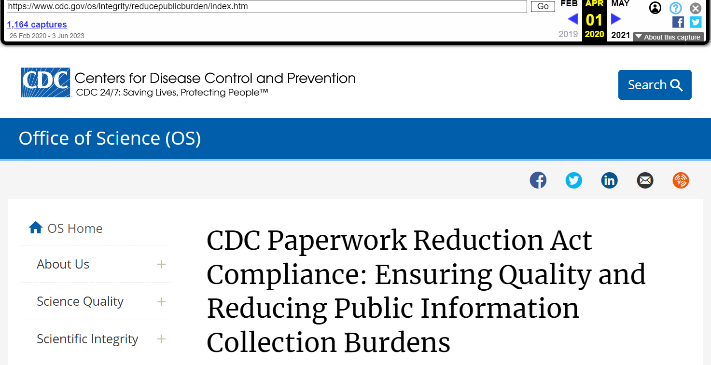
But, finding historical content changes in webpages is hard with the current available interfaces
2016-03-06 2020-04-01
“Protect Privacy” removed
http://www.cdc.gov/od/science/integrity/reducePublicBurden/
@WebSciDL @lesley_elis ACM/IEEE JCDL 2023
Notes:
However, the current web archive interfaces don’t support searching for changes.
Define memento memento.
Left – office of science title protect privacy – 2016
Right – 2020 – protecting privacy is removed
current interface, users view and examine for changes
No way to search

Slide 6
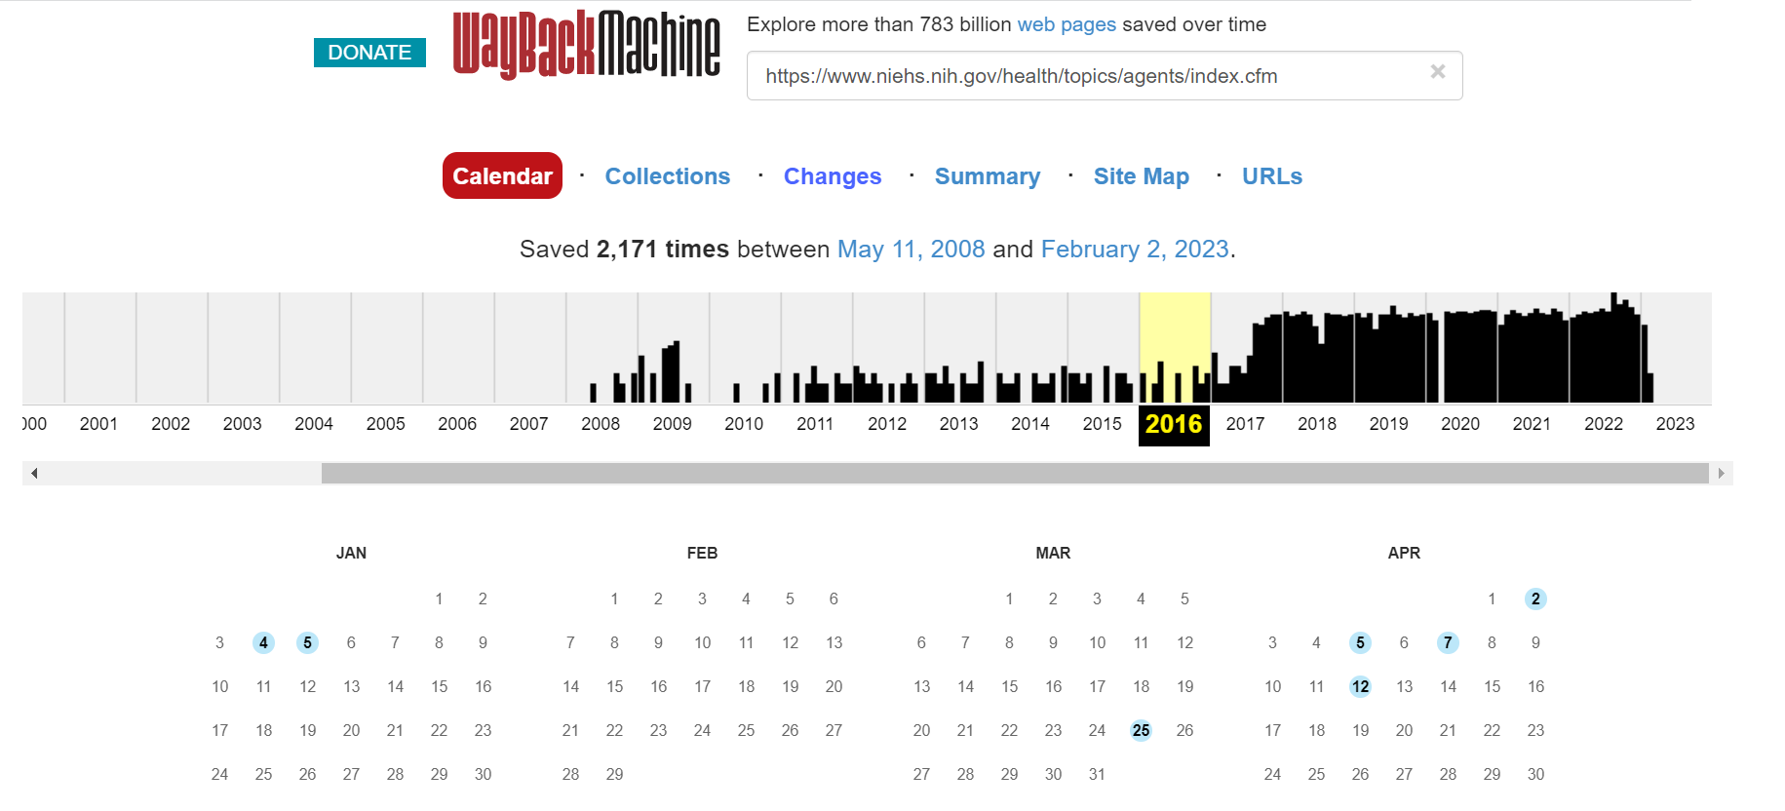
Many web archives only include URI lookup of holdings rather than full-text search
Figure 1, https://web.archive.org/web/20230000000000*/https://www.niehs.nih.gov/health/topics/agents/index.cfm
@WebSciDL @lesley_elis ACM/IEEE JCDL 2023
Notes:
Shortcoming in web archives: only URI look up. No search at all.
One reason – web archives very large, which is prohibitive to indexing.
Smaller archives w/ search may only be for more specialized use.
Another reason – how to display all of these different web page versions in the search results

Slide 7
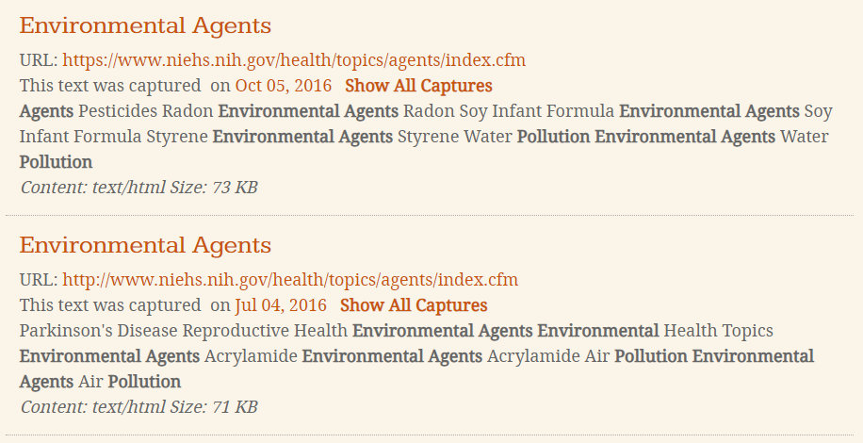
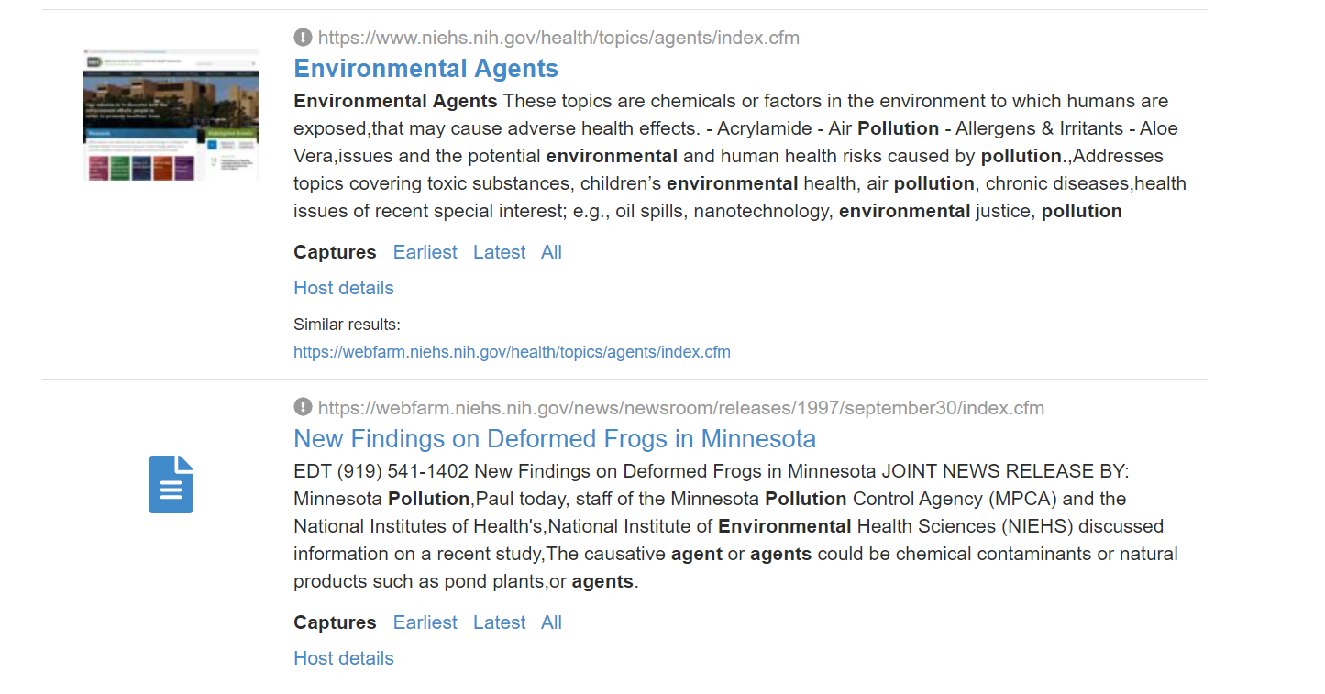
Determining how this page has changed over time isn’t possible from the current search results pages
Archive-It collection SERP. Two captures are shown individually. Wayback Machine collection SERP showing one (grouped) capture.
Figure 2
@WebSciDL @lesley_elis ACM/IEEE JCDL 2023
Notes:
Two approaches to SERPS
Left – archive-it - separate results. useful - want to view multiple versions of the same page. But, clutters the results. no specific changes are pointed out.
Right – WM collection search: grouped result. less cluttered. unclear why that specific version, how many versions match query. Hides change over time.

Slide 8
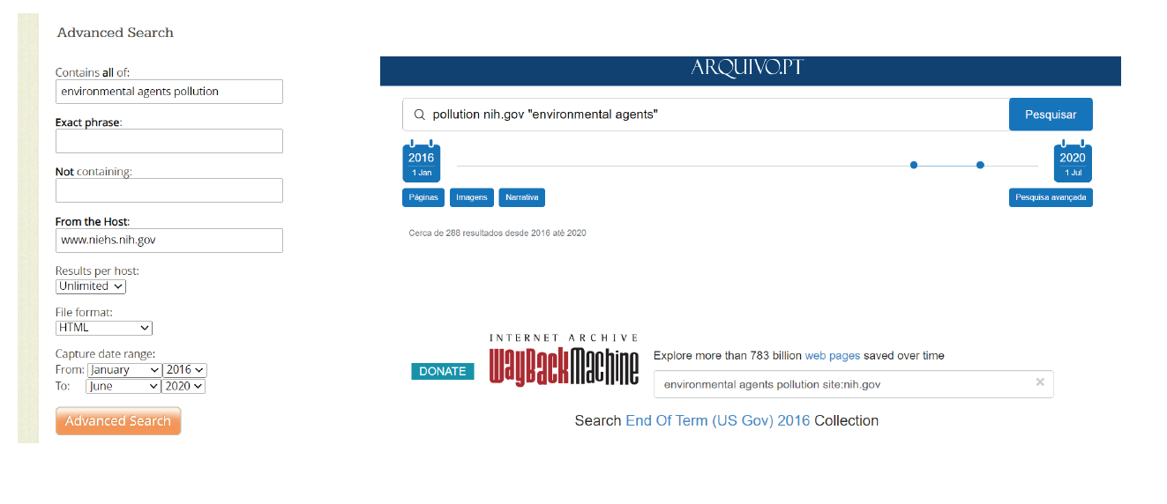
None of the current interfaces can query for terms that have been removed from webpages
Portuguese Web Archive search
Archive-It search
Wayback Machine collection search
Figure 3
@WebSciDL @lesley_elis ACM/IEEE JCDL 2023
Notes:
Even though some search, no interface that supports searching for changes on web pages.
There are many search filters and facets, such as date and domain,
but querying for webpages where a certain term has been deleted isn’t possible.

Slide 9
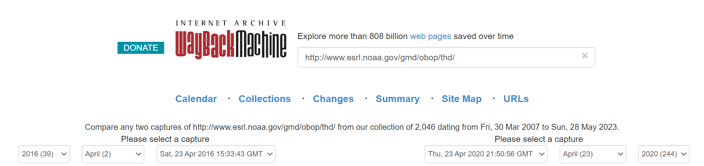
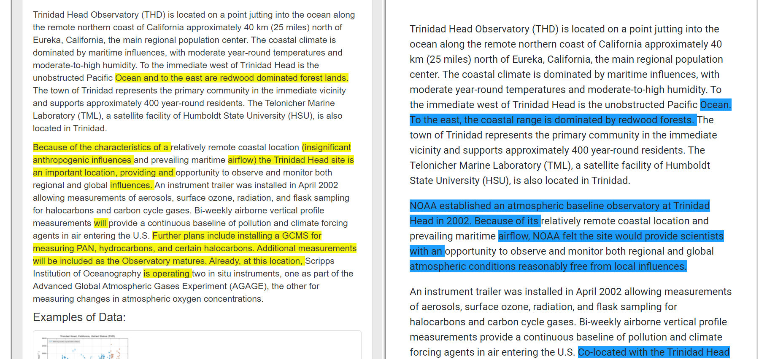
Finding when “anthropogenic” was deleted from this webpage isn’t possible with the current interfaces
4-year timespan
https://web.archive.org/web/diff/20160423153343/20200423215056/http://www.esrl.noaa.gov/gmd/obop/thd/
@WebSciDL @lesley_elis ACM/IEEE JCDL 2023
Notes:
WM changes tool helpful
not possible to search for when that term was removed.
calendar shows amount of change, but not a specific term.
In this screenshot, 4 yr window.
Would have to view many mementos to find change
Also, this tool only works for mementos at the Internet Archive.

Slide 10
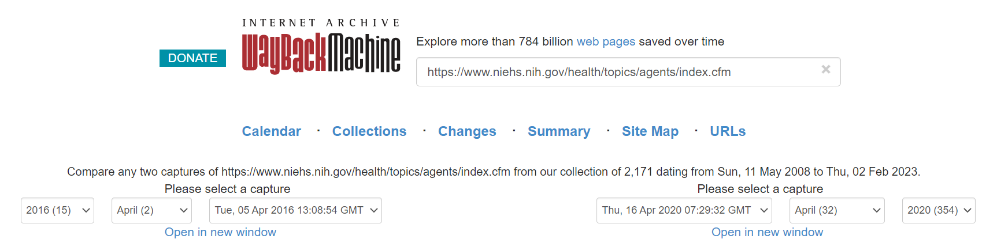
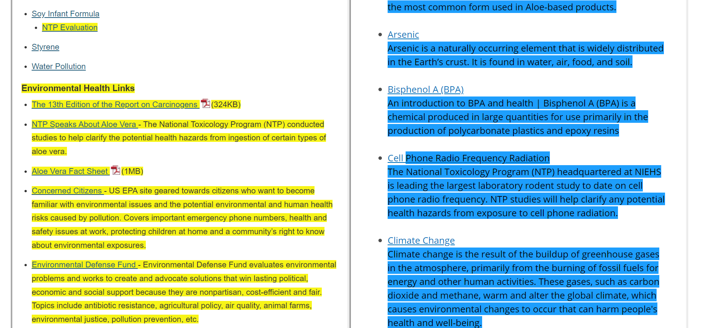
With so much change in this diff, it’s hard to see that “pollution” was deleted from this webpage
Figure 4, https://web.archive.org/web/diff/20160405130854/20200416072932/https://www.niehs.nih.gov/health/topics/agents/index.cfm
@WebSciDL @lesley_elis ACM/IEEE JCDL 2023
Notes:
The changes tool by WM suffers from same problem that all diff tools suffer from: when there is too much change, hard to determine anything meaningful.
This page on nih.gov had the term pollution deleted multiple times, but this important change just blends in with all the rest of the many changes to the page between these two datetimes.

Slide 11
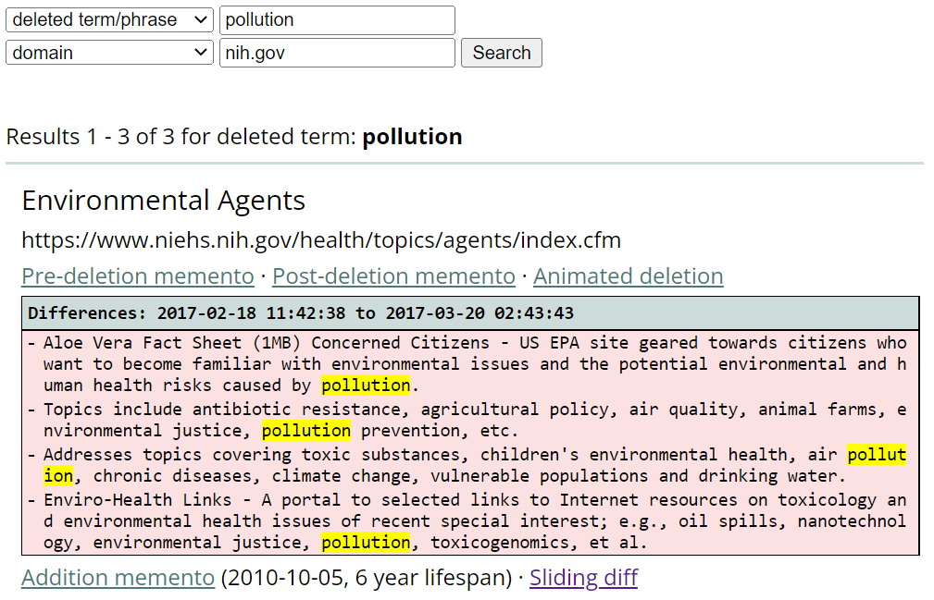
We made a new search interface for web archives to make changes in webpages discoverable
Can now search for change text
Can now see the changes to the page
Can now see when the change occurred
Figure 11
@WebSciDL @lesley_elis ACM/IEEE JCDL 2023
Notes:
So
We’ve created a change text search interface to support users who want to find and view changes to webpages over time
1 – search del term/ phrase
2 – diff in the search result shows the change immediately
3 – datetimes in the search result show when the change occurred

Slide 12
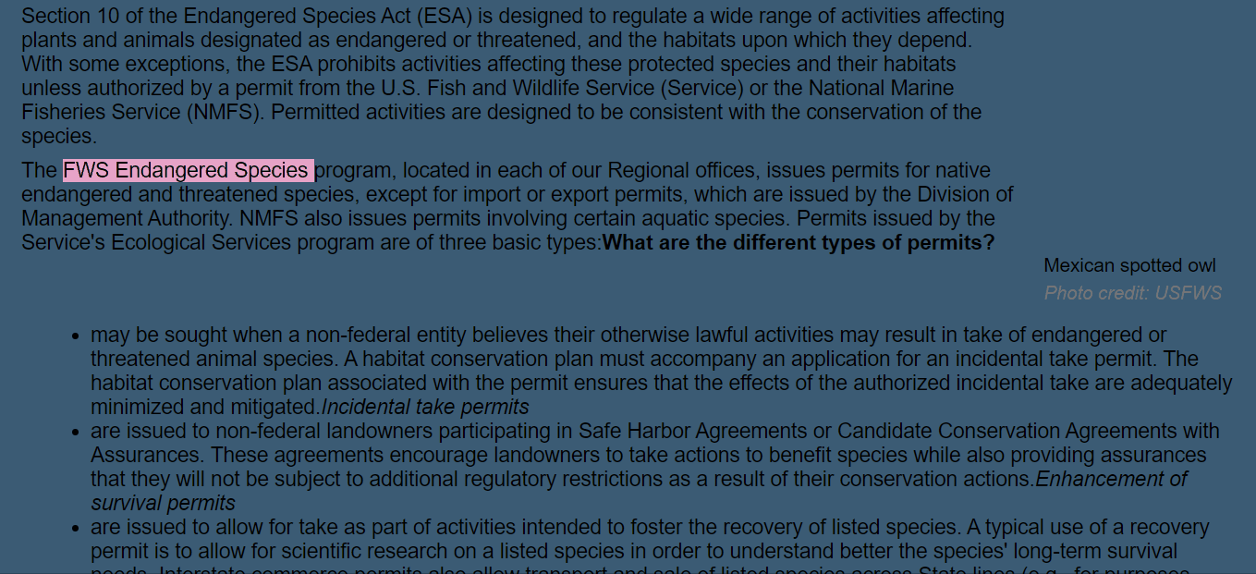
Users can view the change in context using our new animation tool
Figure 9, https://youtu.be/qHSVvcubuYo
@WebSciDL @lesley_elis ACM/IEEE JCDL 2023
Notes:
complementary tool to the WM changes tool.
animates the changes to webpages that match the search query one at a time.
The purpose - show the user the changes to the page in context.
each change is shown one at a time, could be easier to understand than a large diff.

Slide 13
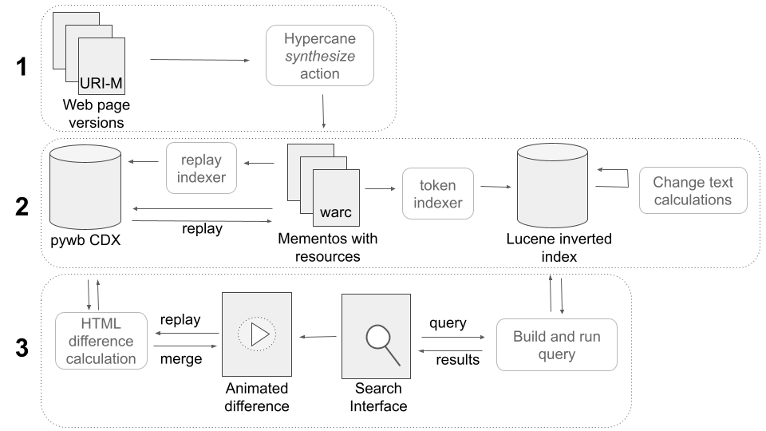
The architecture design for the change-text search engine includes acquisition, indexing, and replay
Figure 6
@WebSciDL @lesley_elis ACM/IEEE JCDL 2023
Notes:
How does this search engine work?
Three levels
The first level focuses on collecting mementos to index.
2nd – indexing the mementos for search and replay
3rd level – change text search UI including animation
I’ll now go over how each of these levels works.

Slide 14

Mementos in public web archives can be synthesized into WARC files using Hypercane
URI-M
warc
HTML
images
JavaScript
CSS
Shawn Jones, Hypercane, https://github.com/lanl/hypercane
@WebSciDL @lesley_elis ACM/IEEE JCDL 2023
Notes:
The first level’s purpose is to acquire mementos to index.
Hypercane by FANTASTIC SESSION CHAIR Dr. SJ, graduated memb WSDL
Hypercane can convert URI-M into a WARC file.
File has things to replay the page, HTML, images, etc.
already have WARCs, completed level 1.

Slide 15
A Lucene index stores the webpage text and change text calculations
UKWA WARC indexer
*NEW*
Change Text Calculations
Coalescing:
Validity range calculation
Added and deleted terms calculations
warc
Lucene inverted index
tokens
metadata
Berberich et al. 2007. A time machine for text search. SIGIR '07. https://dl.acm.org/doi/10.1145/1277741.1277831.
Andy Jackson, UKWA WARC Indexer, https://github.com/ukwa/webarchive-discovery/tree/master/warc-indexer
@WebSciDL @lesley_elis ACM/IEEE JCDL 2023
Notes:
Level 2 indexes all of the content. First – index for search.
We used Apache Lucene; Existing tool - UKWA WARC indexer – tokens (search) and metadata (datetime)
No add/del terms
Validity ranges (Berberich) – Lucene no then yes now
(New) calc sets add/del terms
Post back w JSON

Slide 16
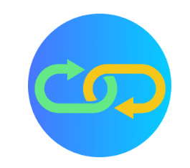
The PyWB CDX index stores the replay information
PyWB CDX
warc
metadata*
*unfortunately the CDX “WARC record length” field is not included in the metadata stored in the Lucene index by the UKWA WARC Indexer,
requiring each WARC to be indexed twice
PyWB, https://github.com/webrecorder/pywb
@WebSciDL @lesley_elis ACM/IEEE JCDL 2023
Notes:
Level 2 also indexes the warcs for replay with PyWB. Bannerless – multiple archives
Dr Jackson (UKWA W indxr) working on it. For now each warc read twice
IF QUESTION Lucene is missing one field (has length of content, needs length of warc record, they’re not interchangeable and don’t have a common formulaic difference)

Slide 17
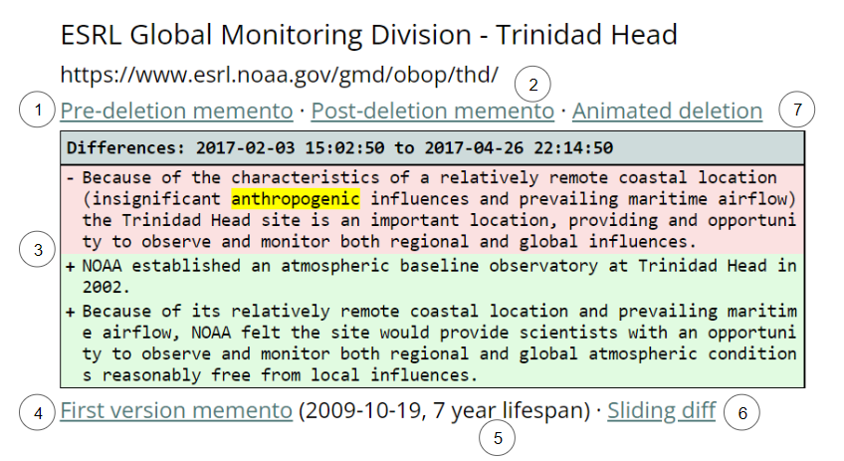
Multiple versions of webpages are grouped together in the SERP to show the differences over time
Links to 3 versions that best show the changes
diff
Links to 2 new ways to view the differences
term lifespan
Figure 7
@WebSciDL @lesley_elis ACM/IEEE JCDL 2023
Notes:
Level 3 is the search UI that the user sees. SOLARIUM
This is Page from earlier (4 yr wind)
In UI – 3 salient versions linked. Pre, post del, add.
Diff snippet - what changed.
Datetimes: lifespan of term, one of journalist tasks
Two additional ways to view differences – anim del, slid diff

Slide 18
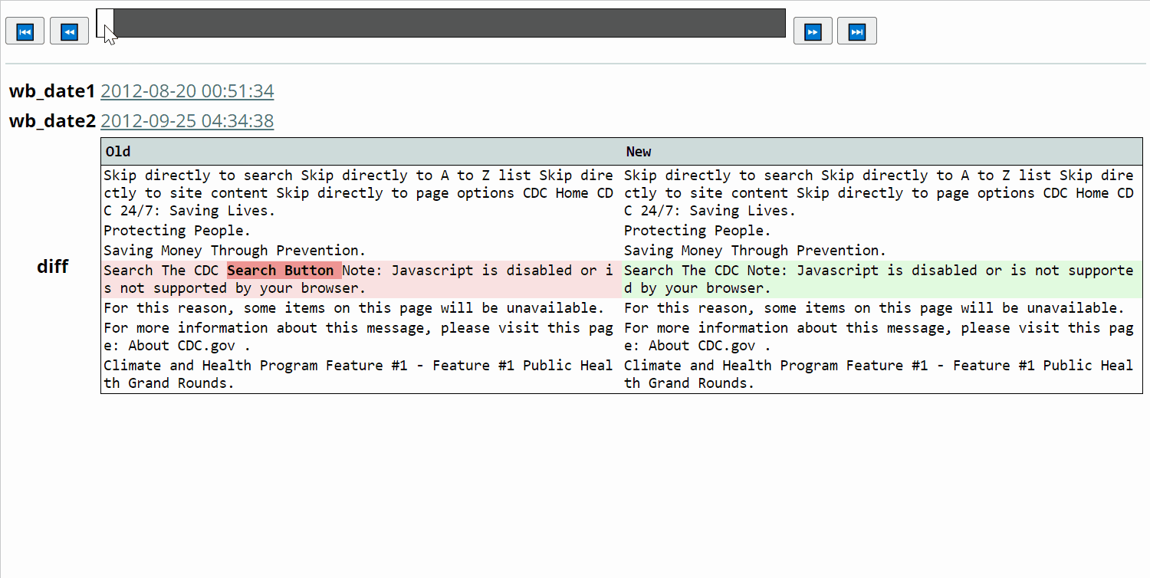
Users can view differences on a webpage over time using a sliding diff tool
Figure 8 - animation
Henley, Austin. Hey Dropbox, why can't I compare file versions like this? https://austinhenley.com/blog/whycanticomparefileversions.html
@WebSciDL @lesley_elis ACM/IEEE JCDL 2023
Notes:
WM changes – only 2 vers of page. + slow b/c replay
Since we indexed all of the text, we can diff and slide through all of the versions quickly.
Buttons skip identical vers
First version – addition
Last version – post deletion
Search term is highlighted
inspired by AH, similar feature for IDEs.

Slide 19
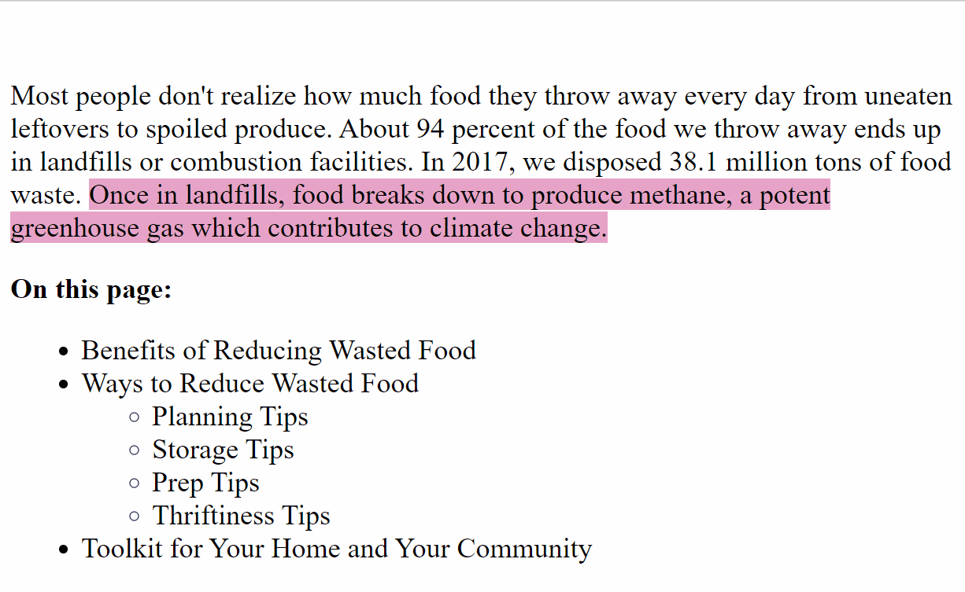
Users can incrementally view changes in context with the animated differences tool
Animated deletion of “gas” on https://www.epa.gov/recycle/reducing-wasted-food-home between 2016-05-30 14:35:25 and 2020-06-22 12:06:32
EDGI, web-monitoring-diff, https://github.com/edgi-govdata-archiving/web-monitoring-diff
@WebSciDL @lesley_elis ACM/IEEE JCDL 2023
Notes:
The animation works by – pre post del mems w PyWB.
EDGI created HTML diff lib (also used WM changes tool)
We used this library to create the merged differences of the two versions.
Then, # the versions, used Javascript -each change individ
Only the differences that contain the search query term.

Slide 20
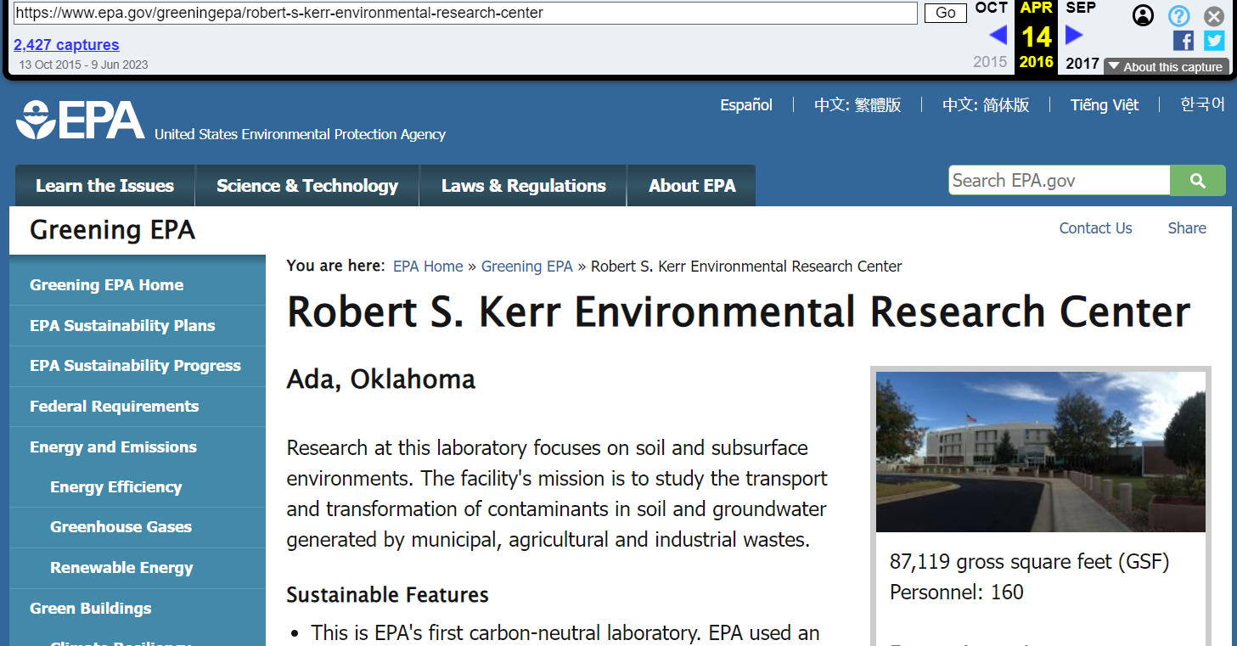
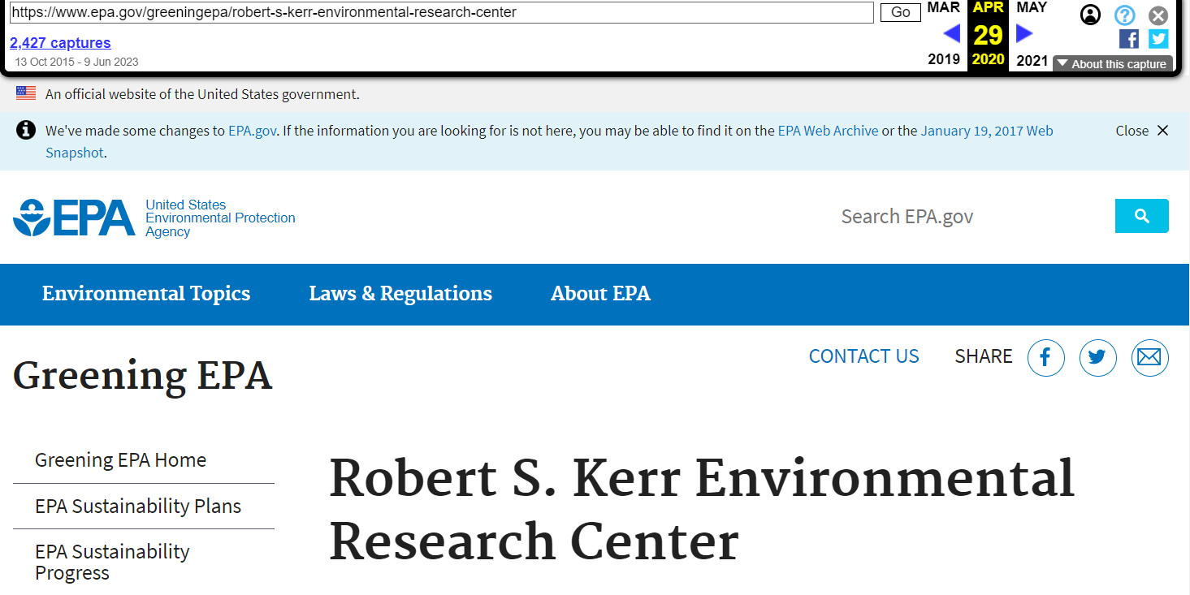
We evaluated this search interface with the EDGI US federal environmental agency websites dataset
40,378 URI-Rs → 9,144 paired mementos
2016 memento
2020 memento to make a pair
Nost et al., Visualizing changes to US federal environmental agency websites, 2016–2020, https://doi.org/10.1371/journal.pone.0246450
@WebSciDL @lesley_elis ACM/IEEE JCDL 2023
Notes:
Well, how does this change text search interface perform?
We needed to test it on a dataset with known changes.
chose EDGI’s 16-20 dataset
40 k URIs
But not all had a memento in both 2016 and 2020
When they did, they called it a paired memento, and there were 9k of these

Slide 21
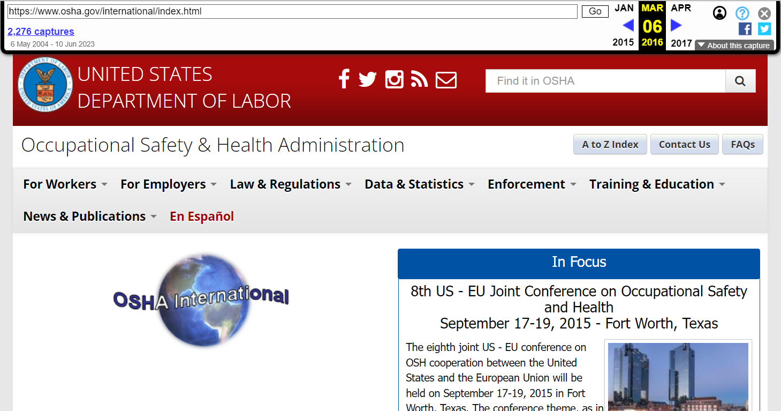
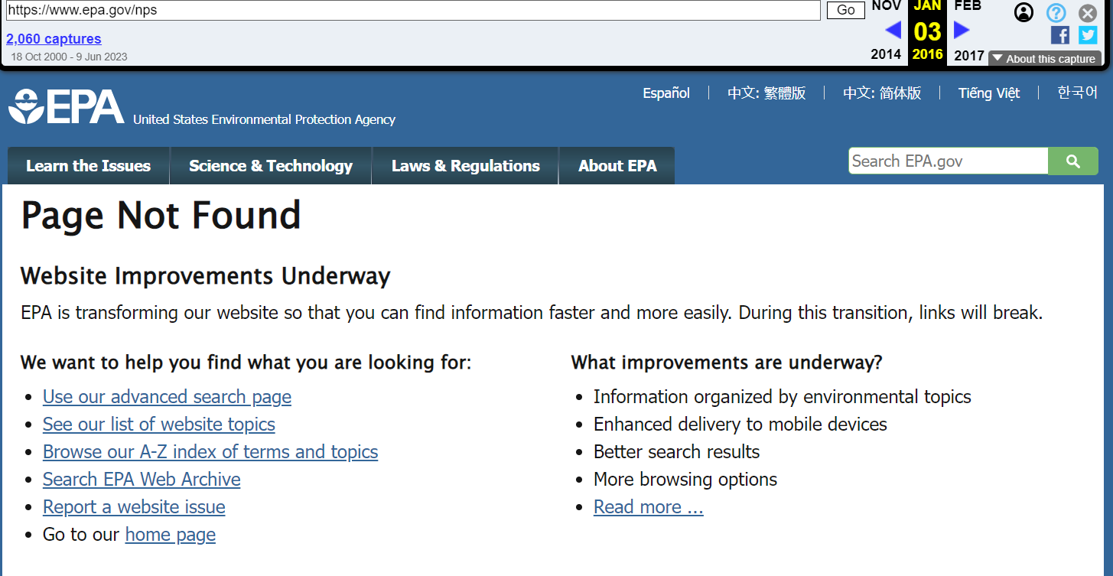

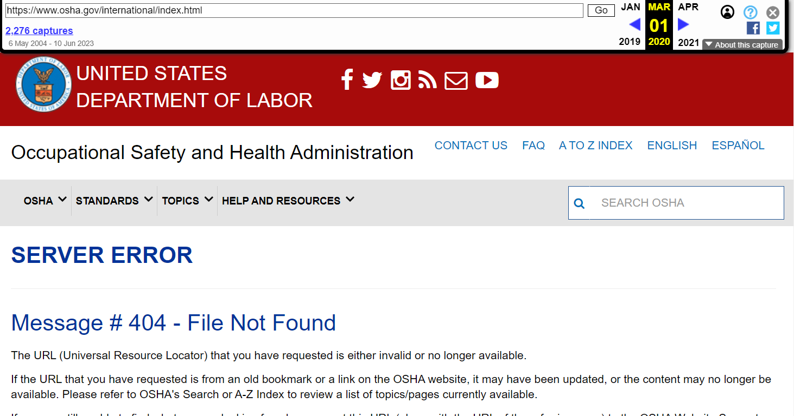
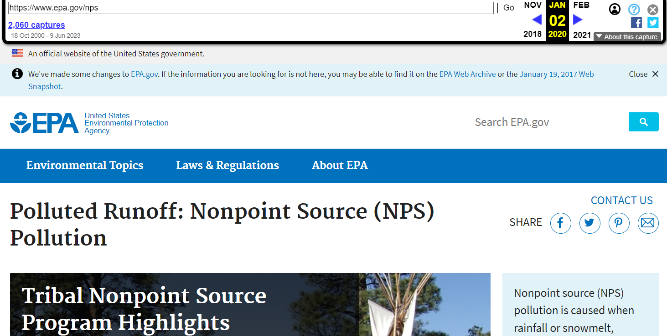
Indexable paired mementos both have a 200 OK status code
404
2016
2020
404
epa robert-s-kerr: 2016 vs 2020 osha.gov/international/index.html: 2016 vs 2020 epa.gov/nps: 2016 vs 2020
@WebSciDL @lesley_elis ACM/IEEE JCDL 2023
Notes:
Useful paired mementos have successful status codes in both 2016 and 2020.
If either of the mementos is missing, or has a non successful HTTP status code (such as a 404 not found or 301 redirect), then it won’t index well for changes.

Slide 22
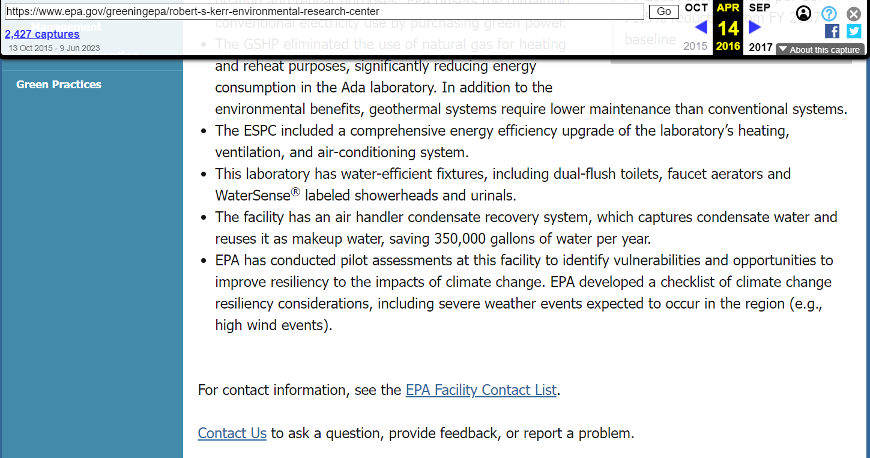
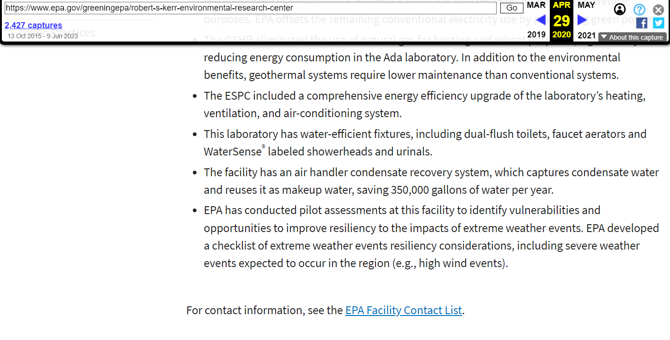
The EDGI dataset is well-suited for this evaluation because the paired mementos contain known changes
epa.gov/greeningepa/robert-s-kerr-environmental-research-center in 2016 vs 2020 (climate change has been replaced with extreme weather events)
@WebSciDL @lesley_elis ACM/IEEE JCDL 2023
Notes:
Well, this dataset only good fit for evaluating if there are changes.
EDGI specifically collected this dataset because they knew the pages were changing for political reasons.
For example, this page every instance climate change replaced with extreme weather events.
So, perfect dataset

Slide 23
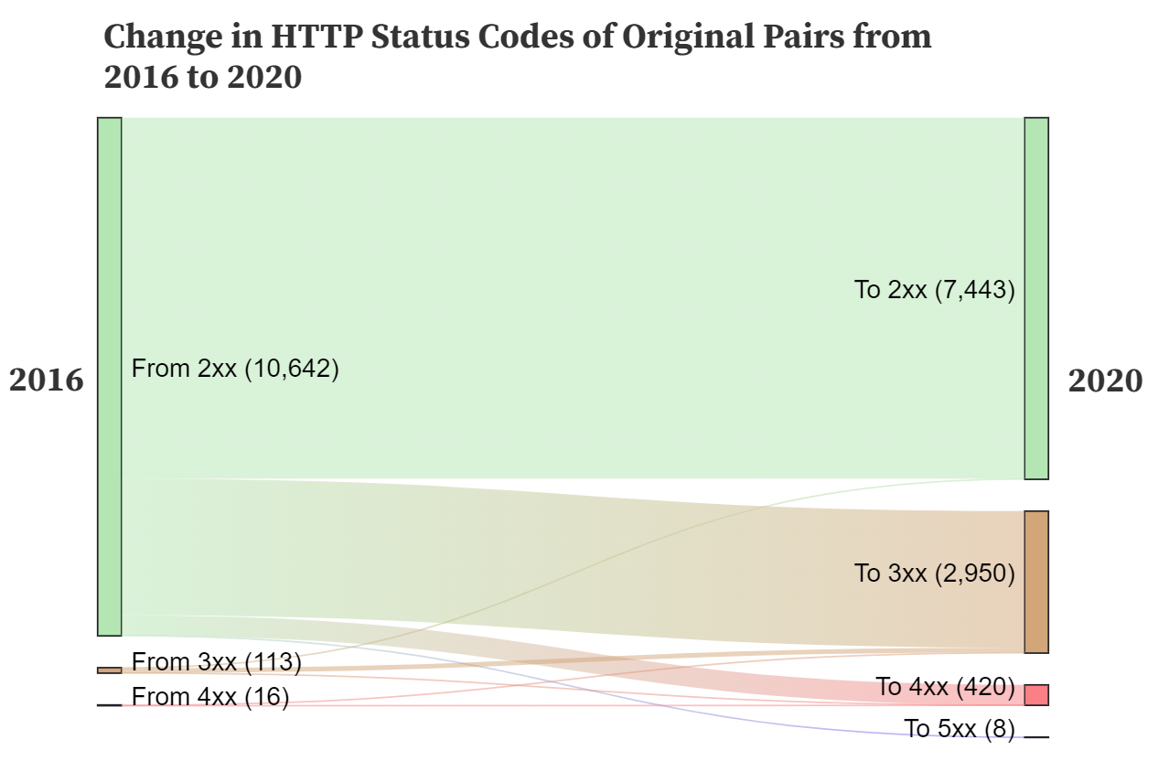
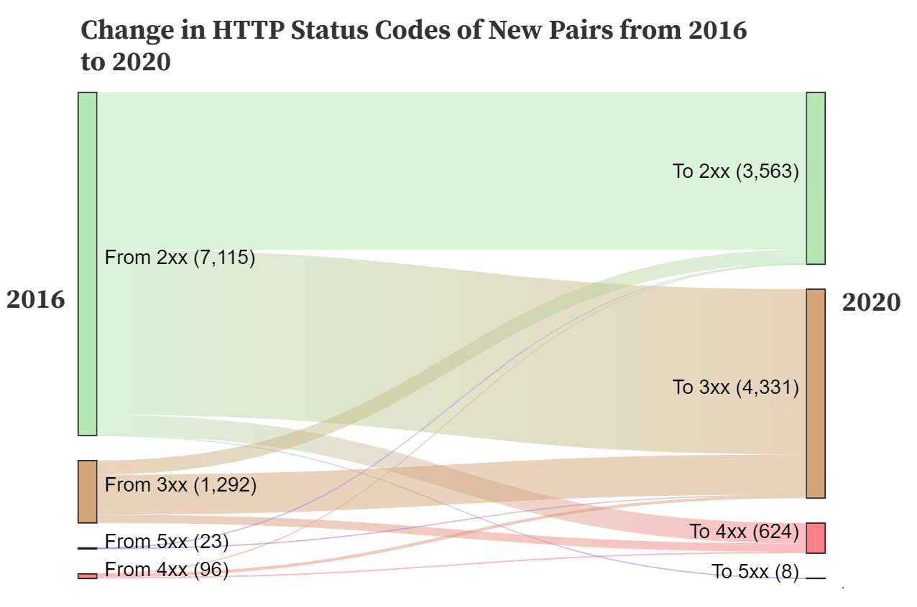
We increased the amount of potentially indexable pairs by 50% by querying multiple web archives
Original - Internet Archive only
Our Extension - multiple web archives
Figure 10
Sawood Alam, Memgator: A Memento Aggregator, https://github.com/oduwsdl/MemGator
@WebSciDL @lesley_elis ACM/IEEE JCDL 2023
Notes:
First, EDGI only checked for paired mementos at IA
We wanted to see if there were more paired mementos if we included other web archives.
We found 3500 more pairs where both mementos had a successful 200 status code.
In the original 9k pairs, 7500 both had 200 status codes.

Slide 24
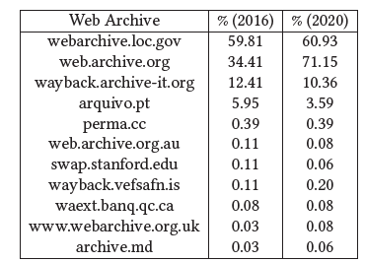
Most of these new indexable paired mementos are located at the Library of Congress web archive
The percentages represent the number of URI-Rs with at least one memento found in the TimeMap
in the specified time range, divided by 3,563.
Table 1
@WebSciDL @lesley_elis ACM/IEEE JCDL 2023
Notes:
This is quite a big increase.
Which web archives held the additional mementos?
These are US government pages, so maybe not surprising LOC WA
We were also surprised to find that IA had more pairs than initially discovered by EDGI.
(maybe some of these crawls were added later. )

Slide 25
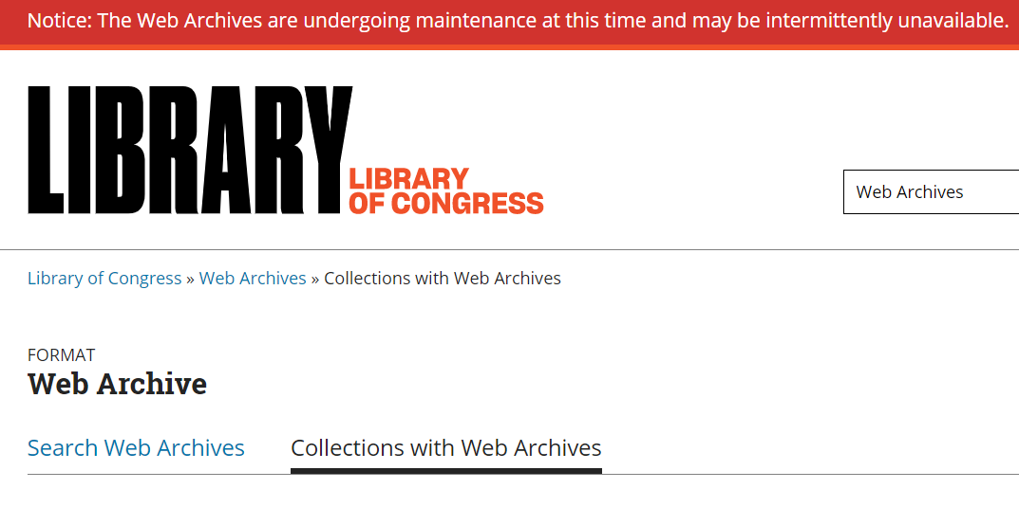
It’s important to have multiple web archives, because any single web archive’s availability is not guaranteed
https://www.loc.gov/web-archives/collections/ - capture saved at Wayback Machine on 2023-06-04
@WebSciDL @lesley_elis ACM/IEEE JCDL 2023
Notes:
Unfortunately, the LOC WA has been down since end of April.
One of the reasons why it’s so important to use multiple web archives is that no one web archive will last forever.
While LOC is an important source to consider for US fed pages, it’s good that other web archives have captures of those pages, too, since LOC is down.

Slide 26
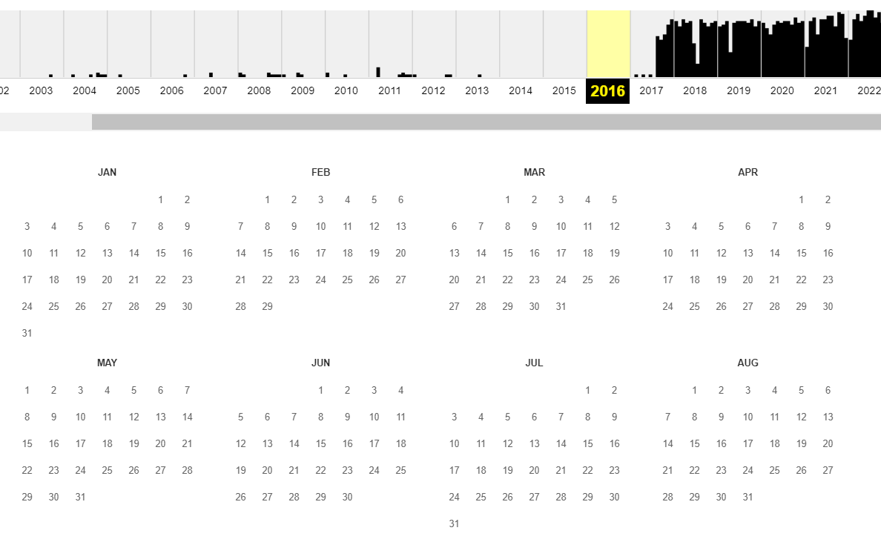
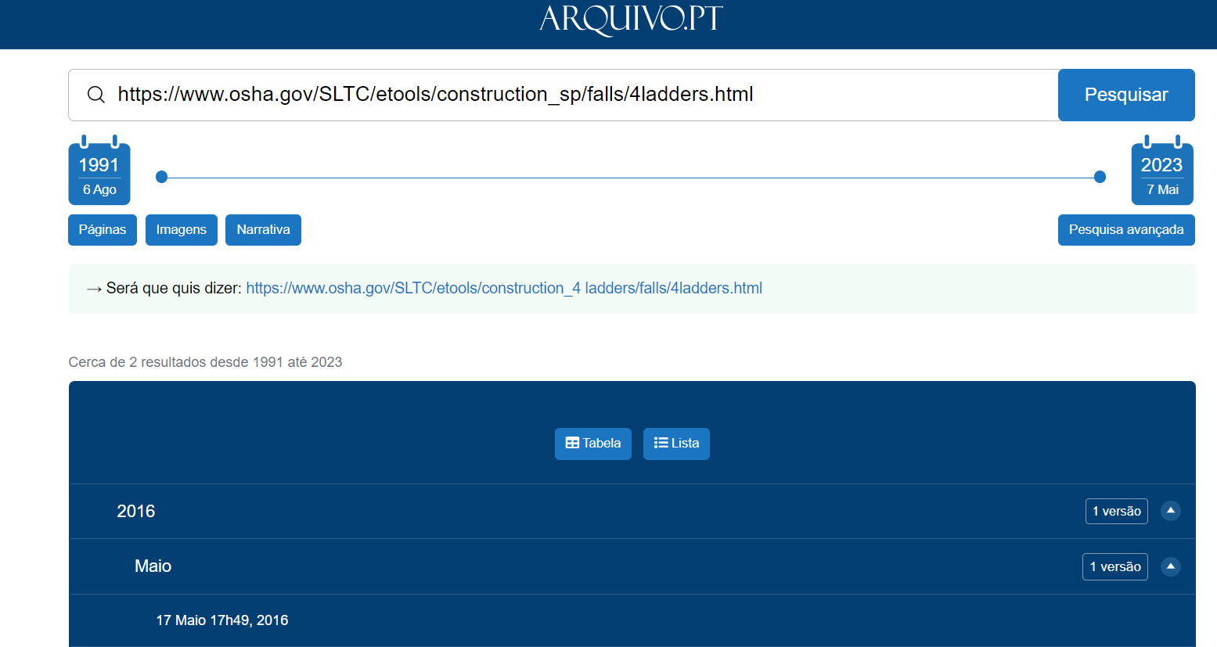
A crawl conducted by the Portuguese Web Archive in May 2016 is not available at other web archives
no captures
one capture
Captures in 2016 for https://www.osha.gov/SLTC/etools/construction_sp/falls/4ladders.html at the Wayback Machine (0) vs Arquivo.pt (1)
@WebSciDL @lesley_elis ACM/IEEE JCDL 2023
Notes:
For example, PWA appears to have conducted a crawl of US federal sites in May 2016.
Many of these websites are not captured anywhere else, including the IA.
About 5% of the EDGI data set extension comes from this crawl.

Slide 27
We indexed a sample of 1,000 paired mementos from the dataset
41 hrs
40 min
2.5 hrs
15 sec
@WebSciDL @lesley_elis ACM/IEEE JCDL 2023
Notes:
chose 1k paired mems from 10k candidates to idx.
Longest - HC. Indexing for PyWB was faster than indexing for Lucene.
The new change text calculation code ran almost instantaneously.
Also tested on index of 200,000 items (including assets) – <1 min.

Slide 28
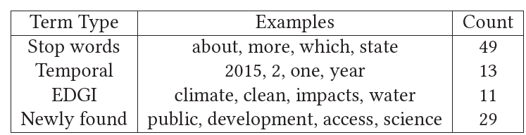
Indexing allows for the discovery and ranking of deleted terms across the corpus
Table 2 - summary of top 100 deleted terms
@WebSciDL @lesley_elis ACM/IEEE JCDL 2023
Notes:
We examined which terms were the most commonly deleted.
How – used python to count deleted terms in json file
Stop terms, temporal terms
EDGI – validate 11/56
wE found 29 new meaningful terms like …
Only possible indexed changes

Slide 29
Future work will enhance the capabilities of the change text system and evaluate its effectiveness
Implement automatic indexing
Enhance added term/phrase capabilities
Incorporate term deletion count into rankings
Categorize tasks of users who view multiple versions of the same page
Conduct a user evaluation of the search UI and animation tool
@WebSciDL @lesley_elis ACM/IEEE JCDL 2023

Slide 30
Conclusion: Search interfaces for web archives should meaningfully group pages without hiding changes
Current search interfaces don’t support users finding changes on webpages
A new change text search interface for web archives allows users to find changes on webpages and when they occurred
The new change text animation allows users to see webpage changes in context
The new change text inverted index supports discovery of corpus wide deleted terms
https://github.com/lesleyodu/webarchives-changetext-search
Lesley received a student travel grant from SIGIR to present at JCDL.
@WebSciDL @lesley_elis ACM/IEEE JCDL 2023
Notes:
Users want to find and view changes over time on web pages, but the current interfaces don’t support this
We created search interface, animation, and can find changes across all pages
Thanks to SIGIR
Thank you. I’m happy to answer questions.

Slide 31
backup slides
@WebSciDL @lesley_elis ACM/IEEE JCDL 2023 June 27, 2023

Slide 32
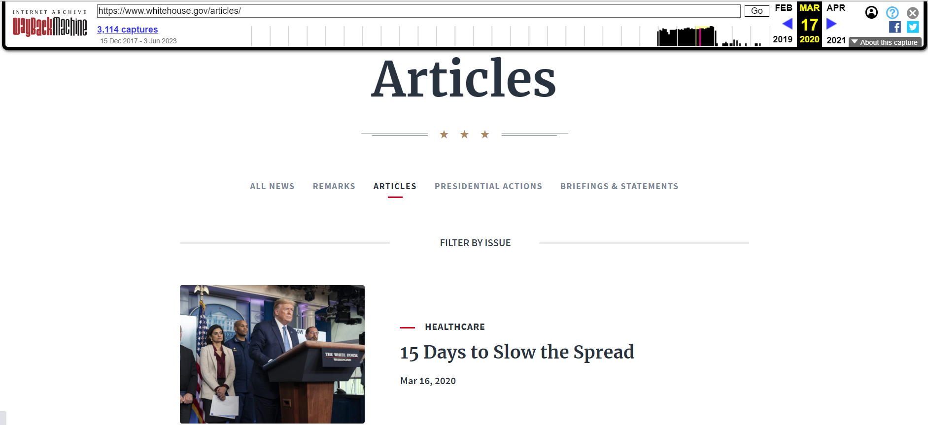
Web archives preserve historical versions of webpages
https://web.archive.org/web/20200317001129/https://www.whitehouse.gov/articles/
@WebSciDL @lesley_elis ACM/IEEE JCDL 2023

Slide 33
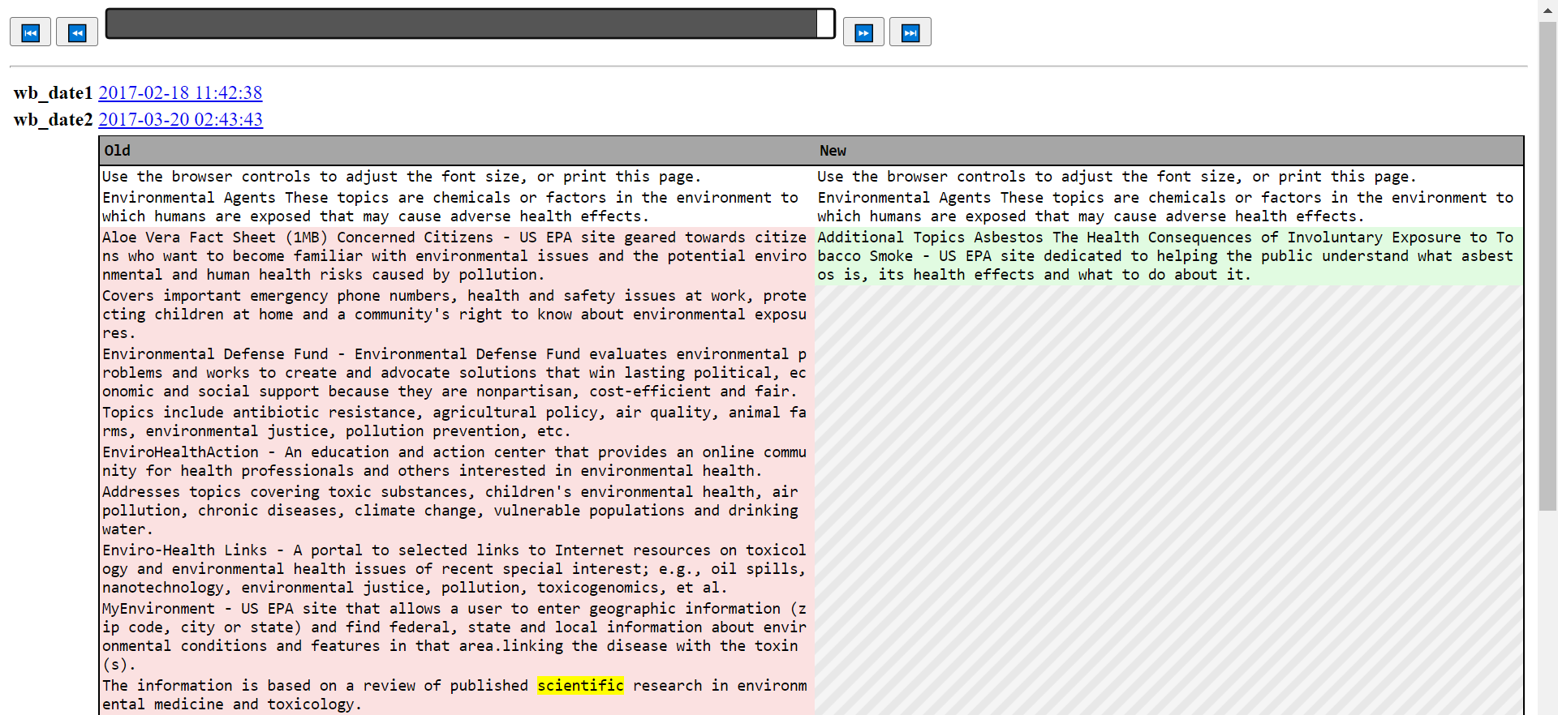
Users can view differences over time using the sliding diff tool
Figure 8
@WebSciDL @lesley_elis ACM/IEEE JCDL 2023

Slide 34

Users can view differences over time using the sliding diff tool
Figure 8 animation
@WebSciDL @lesley_elis ACM/IEEE JCDL 2023

Slide 35
Full list of newly detected common deleted terms
national, support, public, program, resources,
process, data, including, u.s, development,
united, learn, department, action, access,
work, impact, tools, areas, search,
laboratory, technology, efforts, include, natural,
science, planning, address, open
@WebSciDL @lesley_elis ACM/IEEE JCDL 2023

Slide 36
EDGI terms that are also in the top 100 deleted terms
Change, climate, state,
clean, impacts, energy,
water, federal, environmental, global
@WebSciDL @lesley_elis ACM/IEEE JCDL 2023

Slide 37
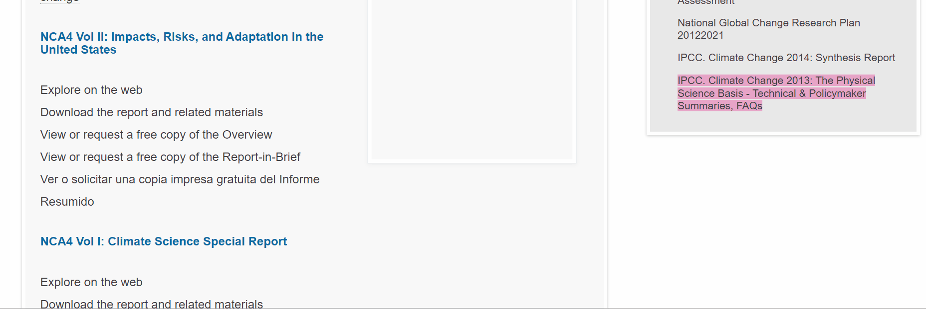
An animated deletion gives the user more time to process each group of changes to a webpage
Animated deletion of “science” on http://www.globalchange.gov/browse/reports?f[0]=field_report_topics%3A2 between 2016-04-27 13:36:37 and 2020-06-30 11:21:50
EDGI, web-monitoring-diff, https://github.com/edgi-govdata-archiving/web-monitoring-diff
@WebSciDL @lesley_elis ACM/IEEE JCDL 2023

